Slide 1


1
Presidency
Presidency
School of Engineering

Slide 2
Department of
Electronics and Communication Engineering

Slide 3
Basics of Electronics and Communication Engineering (ECE3107)
L-T-P-C: 3-0-0-3
By
Dr. K. Gowri
Assistant Professor – Senior Scale
Department of Electronics and Communication Engineering
Presidency University, Bengaluru

Slide 4
MODULE 2
Vision algorithms and applications:
Transforming sensor reading, Mapping Sonar Data, aligning laser scan measurements - Vision and Tracking: Following the road, Iconic image processing, Multiscale image processing
Video Tracking - Learning landmarks: Landmark spatiograms, K-means Clustering, EM Clustering.

Slide 5
2.1 Transforming sensor reading
Introduction:
The presence of sensors in the ubiquitous environment has led to the production of an enormous amount of data.
These sensors belong to diverse categories including planar pressure, thermal, optical, acoustic, and proximity modalities.
They provide information for activity recognition and context-aware models that could be used for a wide range of applications such as automatic monitoring in the smart environment and wellness scene, computer-human-interaction, user experience, etc.

Slide 6
2.1 Transforming sensor reading
There has been extensive research on wearable and pervasive sensors, which record and sense data in the context of human activities; ranging from physical activities (running, sleeping, walking, etc.), such as monitoring gym exercises, analyzing gait patterns, to biological activities (breathing, eating, etc.), such as breathing detection, eating and drinking arm gesture detection.
The task of extracting useful information from the raw sensor data has been performed using various machine learning and data mining techniques.

Slide 7
2.1 Transforming sensor reading
Usually, when the raw sensor data is concerned, the feature extraction is done using statistical methods involving the calculation of the mean, standard deviation, maximum and minimum values.
These features have proven to be quite reliable in tasks related to classification, recognition and segmentation.
Deep learning, Convolutional neural networks (CNN), Recurrent neural networks (RNN) – popular in achieving superhuman accuracy on image classification tasks.

Slide 8
2.1 Transforming sensor reading
Both, CNN and RNN have been used in combination to create systems which are capable of understanding images, and to provide temporal context to these individual images.
Limitations: requirement of large amounts of labeled data to facilitate the training of these very deep networks.
While the computer vision community has facilitated this requirement with large labeled datasets, such as, the ImageNet and MS-COCO datasets for object recognition, classification, detection and captioning; for various other tasks not many labeled datasets exist.

Slide 9
2.1 Transforming sensor reading
The above-mentioned limitation can be bypassed by performing transfer learning, i.e., using labeled data from one domain and transferring the learned knowledge to a target domain.
Transfer learning involves using the knowledge acquired on a specific task, and adapting this knowledge to a different, but related task.
A common scenario for transfer learning involves using a convolutional neural network trained on a very large dataset, and then fine-tuning it on the target dataset which is relatively small in size.

Slide 10
2.1 Transforming sensor reading
A domain is said to be easily visually interpretable if by looking at its visual representation, a human can extract relevant information and sense of the meaning it conveys.
For example, images of everyday objects such as automobiles, animals, landscapes; documents, X-ray, and MRI scan data all belong to the category of easily visually interpretable images.
An average human can easily learn to distinguish between different classes, e.g., several sub-species of animals, or several models of automobiles.
Doctors or radiologists analyze and interpret MRI or X-ray data to detect irregularities in healthy organs.

Slide 11
2.1 Transforming sensor reading
The application of transfer learning on such images is feasible for mainly two reasons.
It is possible due to their nature of being visually meaningful.
There are large datasets from the same domain available within the community to carry out the transfer learning tasks.
However, there exists types of data, such as sensor data, which are not easily visually interpretable, and it is unclear if it would be possible to visually interpret them.
Not visually interpretable data can be, for example, position updates of moving objects in location-based services, fluctuations in the stock market, medical experimental observations, or streaming sensor data.

Slide 12
2.1 Transforming sensor reading
Sensors:
Over the past decades, the availability of sensors has increased substantially and enabled makers and designers to prototype interactive objects rapidly and at low cost.
However, this large variety of components also comes with the challenge of selecting the right sensor from many similar components to find the one that best fits the use case at hand.
Since each sensor has its own specification, understanding what each sensor can sense and how it will work on a prototype can be a time-consuming process.

Slide 13
2.1 Transforming sensor reading
Limitations of reading sensor data:
Extracting information from a datasheet can be cumbersome and confusing since the sensing information may be buried among the chip design, schematic, and other technical aspects.
Datasheets are not standardized, which makes comparing sensors with each other a difficult task.
Since datasheets are text documents, it can be hard to picture what sensors can sense when placed on a prototype.

Slide 14
2.1 Transforming sensor reading
Different Stages of Prototyping with Sensors
Sensor Specifications from Datasheet
Sensor Data Overlay over the Physical Prototype via AR
Live and Recorded Sensor Data Visualization

Slide 15
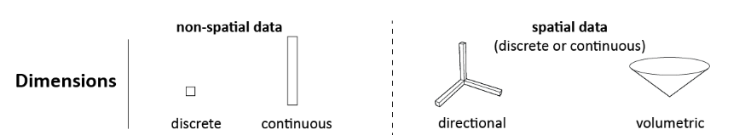
2.1 Transforming sensor reading
Library of visualization primitives:
Dimensionality:
We represent discrete data as a point and continuous data as a bar.
We represent directional data as bars in different directions.
For volumetric data, we display the data as a 3D volumetric shape (e.g., a cone or hemisphere). Dimensional information is rendered as a black outline with no infill.

Slide 16
2.1 Transforming sensor reading
Range
To visualize the range of a sensor, we use the min/max values from the datasheet as the bounds of the visualization.
For continuous non-spatial and directional data, we define the lower bound of the visualization to be equal to the minimum value and the upper bound of the visualization to be equal to the maximum value specified in the datasheet.
For spatial data, the visualization shows the lower and upper bounds of the sensing volume in the size as specified in the datasheet.

Slide 17
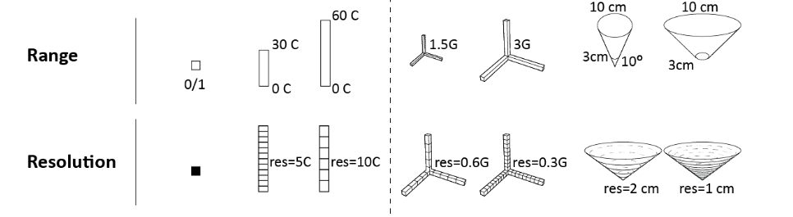
2.1 Transforming sensor reading
Resolution:
We visualize resolution by splitting the bar or volume into segments, with smaller segments representing higher sensor resolutions than larger segments.
We compute the segment size by dividing the sensor’s output bit resolution by the range of the sensor.

Slide 18
2.1 Transforming sensor reading
Sensor Values
We visualize live sensor values by flling in the point, bar, or volume.
For discrete values, if a ’zero’ is read, the point is rendered in 0% opacity and if a ’one’ is read, it is rendered in 100% opacity.
Makers can differentiate between a ’zero’ reading and ’no data’ using the text label that shows the current value.
For continuous values, the larger the received sensor values, the more of the bar or the volume is rendered in 100% opacity.

Slide 19
2.1 Transforming sensor reading
Textual information
We use labels to display the range (min/max), the resolution, and the current sensor value.
For directional data, we also label the axes information, and for volumetric data, we label the angle of the feld of view.
Makers can choose in the user interface which information they want to display.

Slide 20
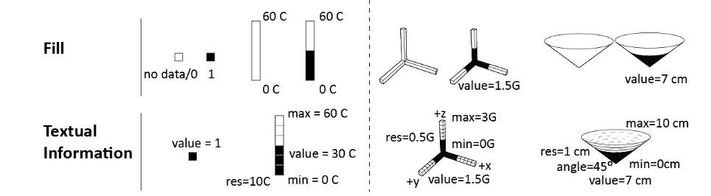
2.1 Transforming sensor reading

Slide 21
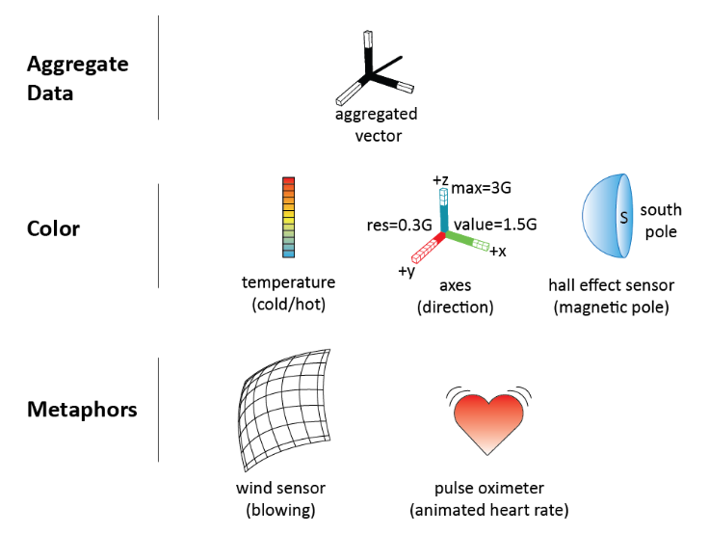
2.1 Transforming sensor reading
Additional Visualizations Attributes:

Slide 22
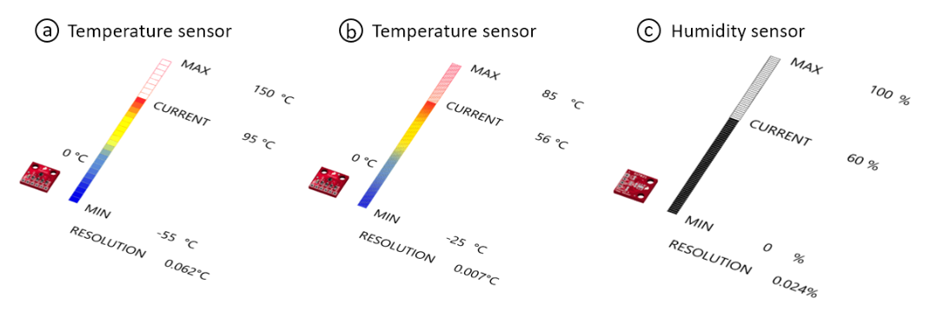
2.1 Transforming sensor reading

Slide 23
2.1 Transforming sensor reading
Steps to transform sensor reading:
Loading Sensor Information from Sensor Database
Visualizing Sensor Data
Augmented Reality visualization
Reading Live Sensor Values
Recording Sensing Data
Sensing Area Overlap

Slide 24
2.2 Mapping SONAR Data
Advances in technology have since enabled the deployment of Remotely Operated Vehicles (ROVs) and Autonomous Underwater Vehicles (AUVs), which have revolutionized ocean exploration by automating complex tasks and reducing dependence on human operators.
Despite these technological advancements, underwater navigation and object detection remain challenging due to the limitations of optical sensors.
Water turbidity, light attenuation, and scattering severely degrade visual data quality, making camera-based imaging unreliable in most sub-sea operations.

Slide 25
2.2 Mapping SONAR Data
Sonar technology has emerged as a viable solution for underwater detection and navigation, as it operates using acoustic waves that can penetrate murky waters and function independently at ambient lighting conditions.
Sonar systems are generally categorized into single-beam and multi-beam types.
Multi-beam sonars provide extensive spatial coverage and high-resolution 3D reconstructions, but their cost and complexity limit accessibility for smaller research or commercial platforms.

Slide 26
2.2 Mapping SONAR Data
Sonar technology has emerged as a viable solution for underwater detection and navigation, as it operates using acoustic waves that can penetrate murky waters and function independently at ambient lighting conditions.
Sonar systems are generally categorized into single-beam and multi-beam types.
Multi-beam sonars provide extensive spatial coverage and high-resolution 3D reconstructions, but their cost and complexity limit accessibility for smaller research or commercial platforms.

Slide 27
2.2 Mapping SONAR Data
Single-beam sonars—such as the Blue Robotics Ping360—employ a mechanically rotating transducer to sweep across a specified range, generating 2D polar representations of the surrounding environment.
The sonar scanned the environment incrementally, recording intensity values within a range of 0-255 at each angular position.
These intensity values represent the strength of acoustic reflections from objects within the field of view.
The raw Ping360 sonar output is inherently represented in polar coordinates (range versus bearing).

Slide 28
2.2 Mapping SONAR Data
Each beam corresponds to a specific bearing angle, and each range bin encodes the reflected amplitude.
For interpretability and machine learning analysis, these polar data are converted into Cartesian occupancy maps, where both axes rep- resent spatial distance.
Signal filtering is used to ensure only valid data points within the useful scanning range were retained for analysis.
Following this, a statistical threshold approach was applied to further refine the region of interest (ROI) .
This approach ensured the removal of noise while preserving significant reflections from objects.

Slide 29
2.2 Mapping SONAR Data
The data is manually inspected and transformed into polar coordinates and converted into a grayscale image format for training the deep learning networks.
With this types of input, the model learns to separate objects from the back- ground based on intensity variations detected by the sonar.

Slide 30
2.3 Aligning LASER Scan Measurements
Precise localization is a prerequisite for many autonomous systems, such as robotics, unmanned aerial vehicles, etc.
Also, indoor positioning is an especially challenging problem, where localization cannot be achieved by GPS due to the satellite signal being greatly attenuated.
While the traditional radio-based indoor positioning technologies, such as Bluetooth, Wi-Fi, Radio-frequency Identification (RFID) and ultra-wideband (UWB), still have some disadvantages in terms of low accuracy, high latency, electromagnetic interference or high hardware cost.

Slide 31
2.3 Aligning LASER Scan Measurements
The localization technology based on visible light communication (VLC), which is referred as visible light positioning (VLP), has attracted intensive attention as it can provide high accuracy positioning based on the existing lighting infrastructure.
The modulated LED broadcasts its unique identity (ID) via switching at a high frequency imperceptible to the human eye, but which can be recognized by photodiodes (PD) and rolling shutter effect (RSE) cameras.
The LED-ID can be mapped/modulated once for all since they are normally fixed and not easily vulnerable to environmental changes.

Slide 32
2.3 Aligning LASER Scan Measurements
Sensors are imperfect, and their measurements are prone to errors.
Sensors should be carefully mounted and aligned in order for your application to receive optimum results.
Navigation denotes the robot’s ability to determine its own position in its frame of reference and then to plan a path towards some goal location.
The most important consideration to reduce measurement error is aligning the sensor beam so that it is parallel to the dimension to be measured.

Slide 33
2.3 Aligning LASER Scan Measurements
The easiest example to describe is height.
If we want to measure the height of an object with a ruler, you would want that ruler to be perfectly up and down.
If the ruler weren’t perfectly up and down, we’d expect an error with your measurement.
It’s the same with the laser beam on our sensors.
We’d ideally want to align the beam so that it is perfectly up and down to measure height.
Any deviation from that alignment would introduce an error in the measurement.

Slide 34
2.3 Aligning LASER Scan Measurements
While truly perfect alignment is impossible, with care and a well-made fixture or alignment bracket, we often can get the alignment accurate enough to reduce the alignment error to significantly less than the sensor’s error.
The angle between the beam and the surface of the target can also be a source of error.

Slide 35
2.3 Aligning LASER Scan Measurements
The reasons for the laser beam of the sensor is to strike the target surface as close to perpendicular as possible.
While the laser spot from our sensors often looks like a single point on the target, it does have a diameter.
# The more angled the target is, the more the spot stretches out on the target.
#This does make it more difficult for the sensor to know where the center of that spot is, and that can cause errors.

Slide 36
2.3 Aligning LASER Scan Measurements
An angled target will usually reflect more light away from the sensor’s detector.
# The less light the detector gets, the harder it is for the sensor to distinguish the measurement from other light noise.
# That can reduce the measurement accuracy, increase the measurement time, or both.
# This problem increases with the shininess of the target.

Slide 37
2.3 Aligning LASER Scan Measurements
3. An angled or rough target that is shiny can cause the opposite problem — direct reflection into the detector.
# If there is “specular” or direct reflection, that shows up on the detector as a second peak that has no relation to the distance.
# This can result in measurements that are completely incorrect or keep the sensor from offering a measurement at all.

Slide 38
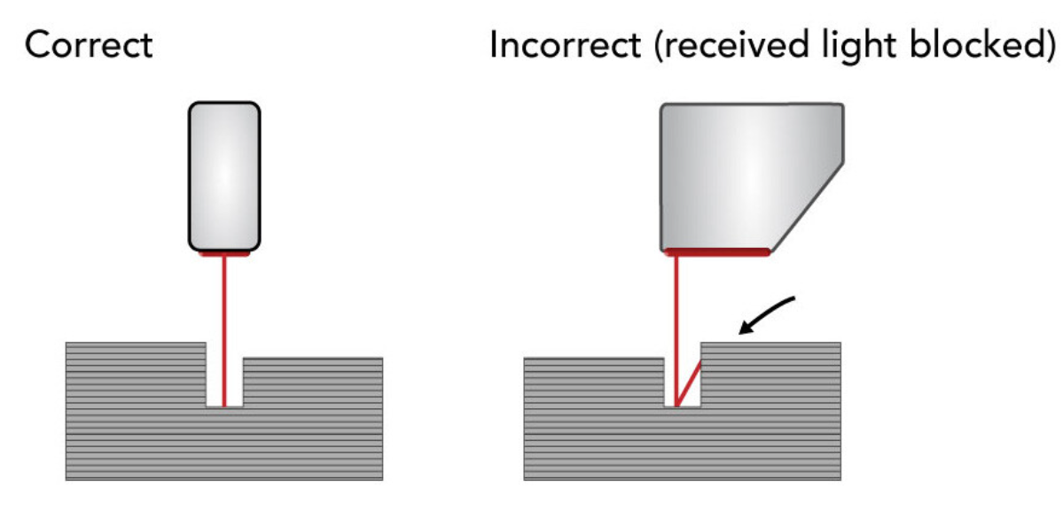
2.3 Aligning LASER Scan Measurements

Slide 39
2.3 Aligning LASER Scan Measurements
3D laser scanner measurement:
It is an advanced method for precise three-dimensional measurement of objects using laser line triangulation sensors, also known as laser scanners.
This technology enables the accurate determination and comparison of measured values such as length, width, height, angle, radius, flatness, parallelism, diameter, defect sizes and more.
Unlike traditional 2D image processing with cameras, 3D laser scanner measurement enables a three-dimensional representation of an object.

Slide 40
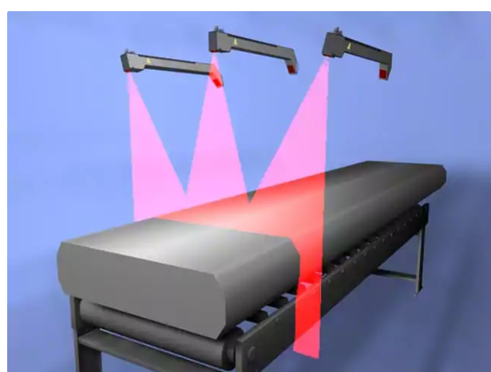
2.3 Aligning LASER Scan Measurements
3D laser measurement of an aluminium block

Slide 41
2.3 Aligning LASER Scan Measurements
Typical industries and sectors where 3D laser scanner measurement is used include:
Metalworking
Mechanical Engineering
Welding technology
Automotive
Battery manufacturing
Aerospace
Smartphone manufacture

Slide 42
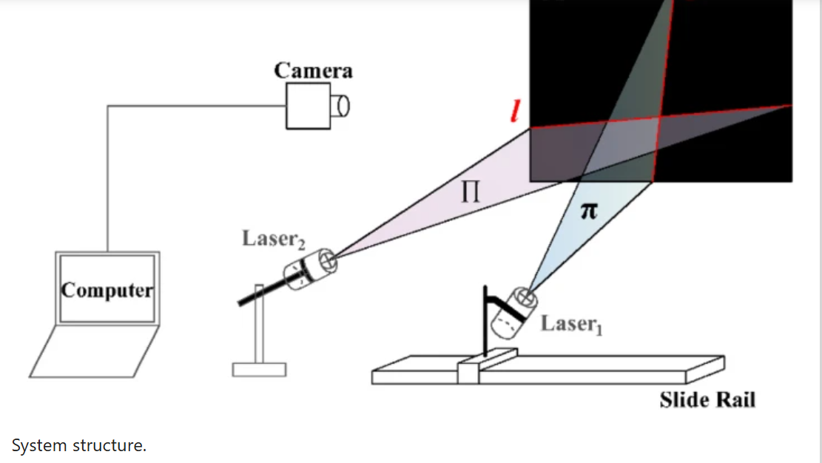
2.3 Aligning LASER Scan Measurements
3D laser measurement

Slide 43
2.3 Aligning LASER Scan Measurements
a

Slide 44
2.3 Aligning LASER Scan Measurements
a

